Slide 1
Cooperation Systems – Final presentation Visual augmented reality manual support
A. Droste, A. Machmer, A. Mantel, J. Schwede
Department for computer science
7th of February 2019

Slide 2
Our cooperation system (1/3) – idea
AR support for the collaborative usage of (operation) manuals
e.g. build your furniture together with additional complementary information
Supporting through Augmented Reality
Different roles possible but not necessary
“Searcher”
“Builder”

Slide 3
Our cooperation system (2/3) – goals
Is a AR support for manuals useful
Do users accept this kind of support
Do they want this support
Can AR support the users with their task in this context

Slide 4
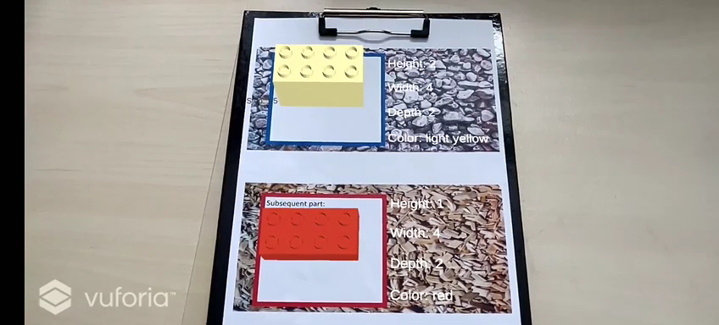
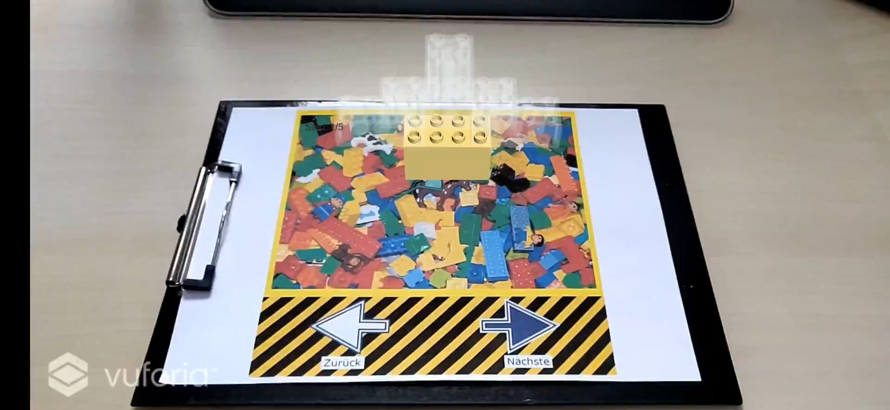
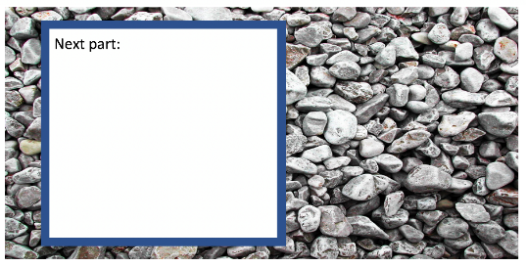
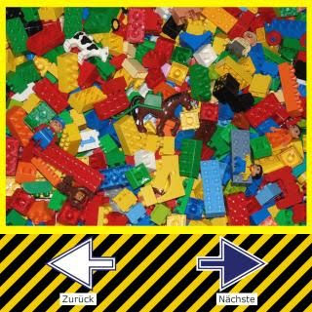
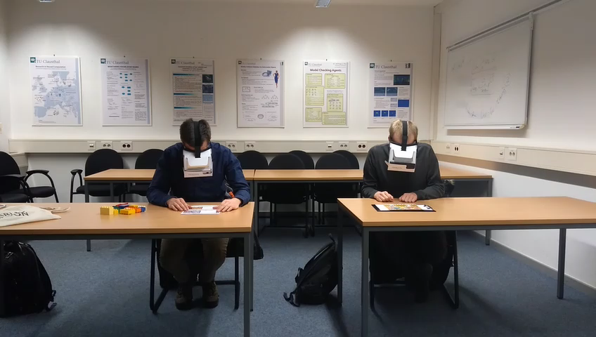
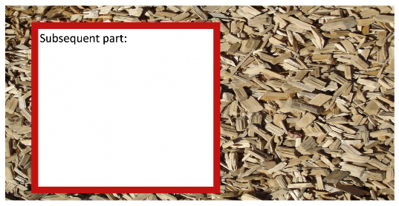
Our cooperation system (3/3) – prototype
Marker for searcher (show next parts)
Marker for builder (show steps to assemble)

Slide 5
Concepts for this cooperation system
Social interaction and coordination tool
properties of parts in list of next parts
Roomware
Awareness
All parties are always aware of the progress and the actual following task
transparency of bricks in model to show progress
Synchronous bidirectional communication support
Co-located (AR shared space)
In general a symmetric system design (Exploring, working on the same content, build/assemble the furniture together (teamwork))
Can also be used in an asymmetric scenario (Helper-Expert)

Slide 6
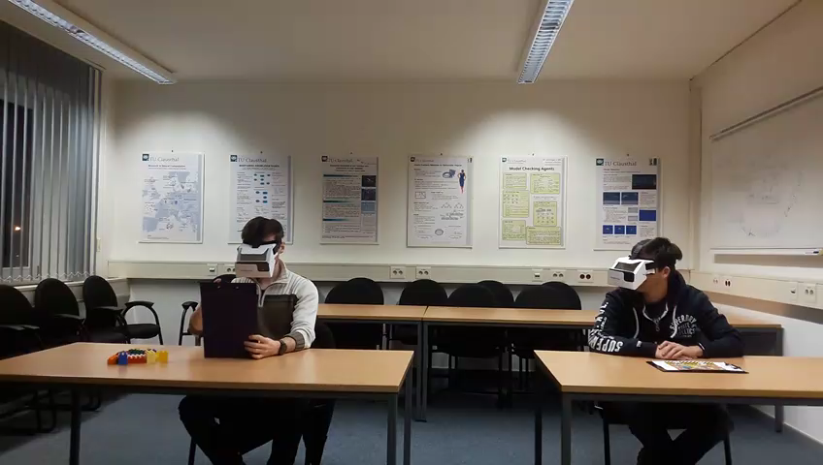
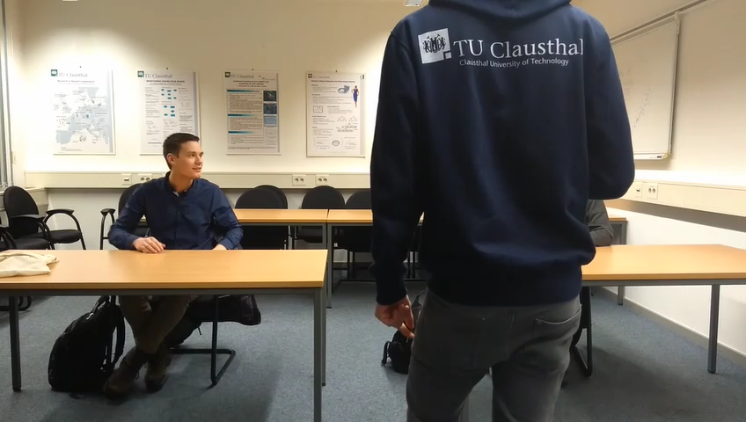
Evaluation
user studies
Questionnaires
Time measurement
AR supported manual
Normal manual
Different orders of execution
AR first / Normal first
Kirkpatrick Model
Reaction – Do the users need this support?
Learning – Can users work better together to build their furniture?
(Transfer) – Can they use the knowledge with different manuals?
(Results)

Slide 7
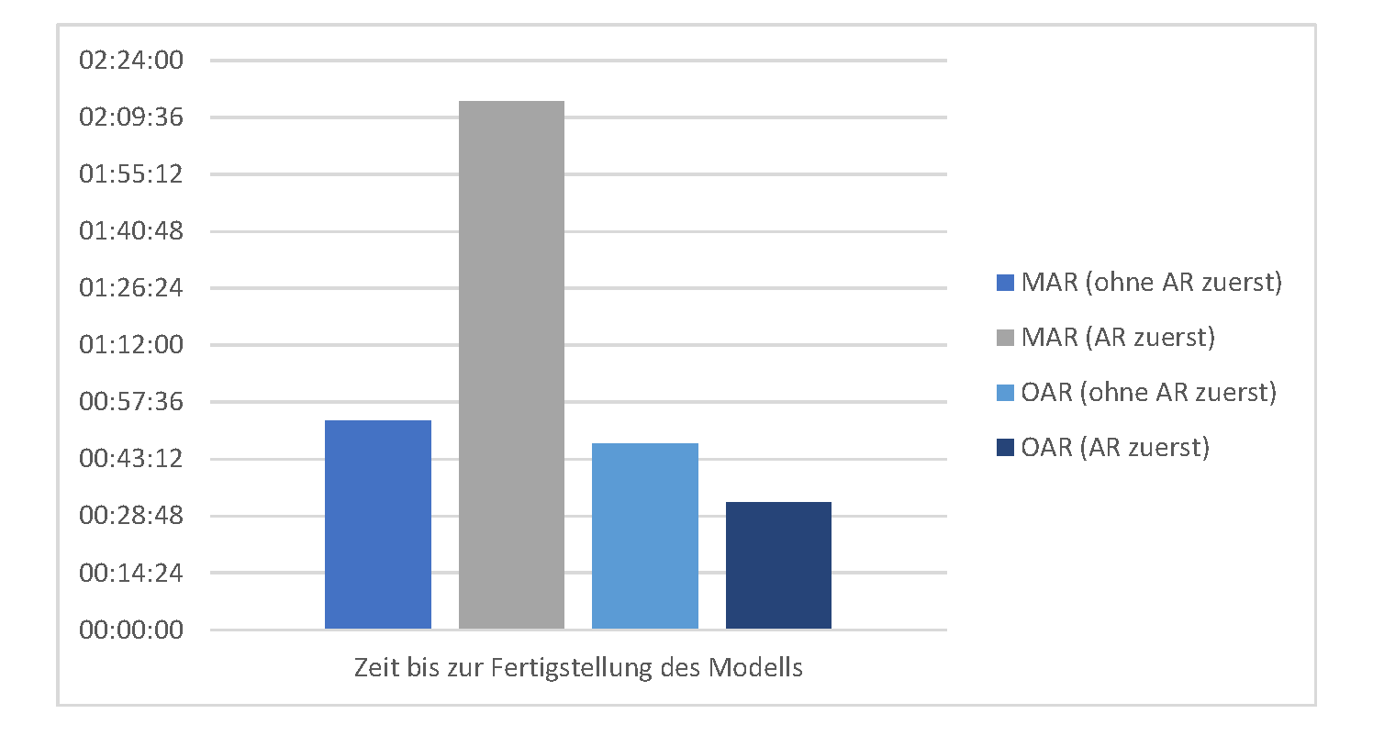
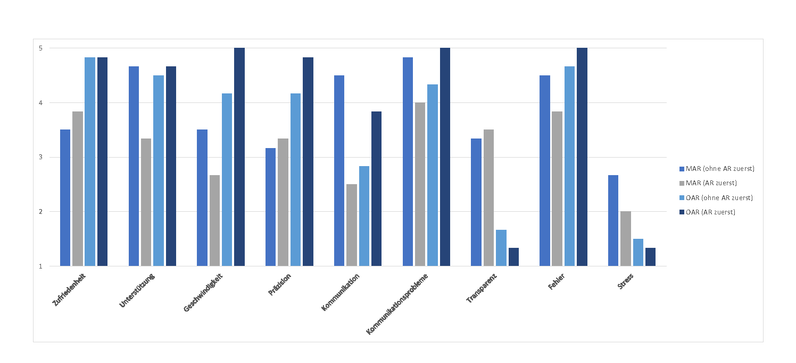
Evaluationresults (1/2)
Without AR building is faster
The users need time to get to know the technology and use is
The users feel more comfortable without AR
AR brings awareness and transparency

Slide 8
Evaluationresults (2/2)
System is firstly to difficult to understand
Minimize communication between partners
Different opinions
this reduces the fun during building
makes following the manual more efficiently

